Slide 1

A PROJECT PRESENTATION
ON
FABRICATION AND MECHANICAL PROPERTY INVESTIGATION OF AL-7075 REINFORCED WITH SIC AND GRAPHITE
By
AVULA GANESH (19F21A0302)
C. MANOHAR (20F25A0310)
K. RAVEENDRA ACHARI (19F21A0319)
K.SAI KUMAR (19F21A0321)
S. PURUSHOTHAM YADAV (19F21A0315)
Under the esteemed guidance of
Mr. S. CHANDRASEKHAR _{M.Tech,}
Assistant Professor,
Department of Mechanical Engineering

Slide 2
Abstract
Composite material is defined as combination of two or more materials and to prepare and measure the characteristics of in detail about material. It can be classified into three types one is metal matrix composite, polymer matrix composite, ceramic matrix composite. The present work is on metal matrix composite “The present work deals with the preparation and mechanical characterization of Aluminium 7075 metal matrix reinforced with silicon carbide and graphite. Silicon carbide and graphite can be considered in different percentages like (2+3), (4+3) and (6+3). By using these materials to prepare and investigate the Mechanical characteristics like Ultimate tensile strength, Breaking strength, Rockwell hardness, Brinell hardness, Compression strength and toughness.”
Aluminium Metal Matrix Composites (AMMC) have various properties which makes it to be applicable into various places like automobile, military industries, aerospace, building constructions and others due to light weight, thermal properties, stiffness, high mechanical strength corrosion resistance. During the analysis of the composite matrix of Aluminium, the properties / characteristic were investigated.
key words: AMMC’s, Stir casting, Mechanical properties of Aluminium 7075.

Slide 3
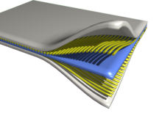
introduction
COMPOSITE MATERIALS:
A composite material can be defined as a combination of two or more materials that results in better properties than those of the individual components used alone. In contrast to metallic alloys, each material retains its separate chemical, physical, and mechanical properties. The two constituents are a reinforcement and a matrix. The main advantages of composite materials are their high strength and stiffness, combined with low density, when compared with bulk materials, allowing for a weight reduction in the finished part.

Slide 4
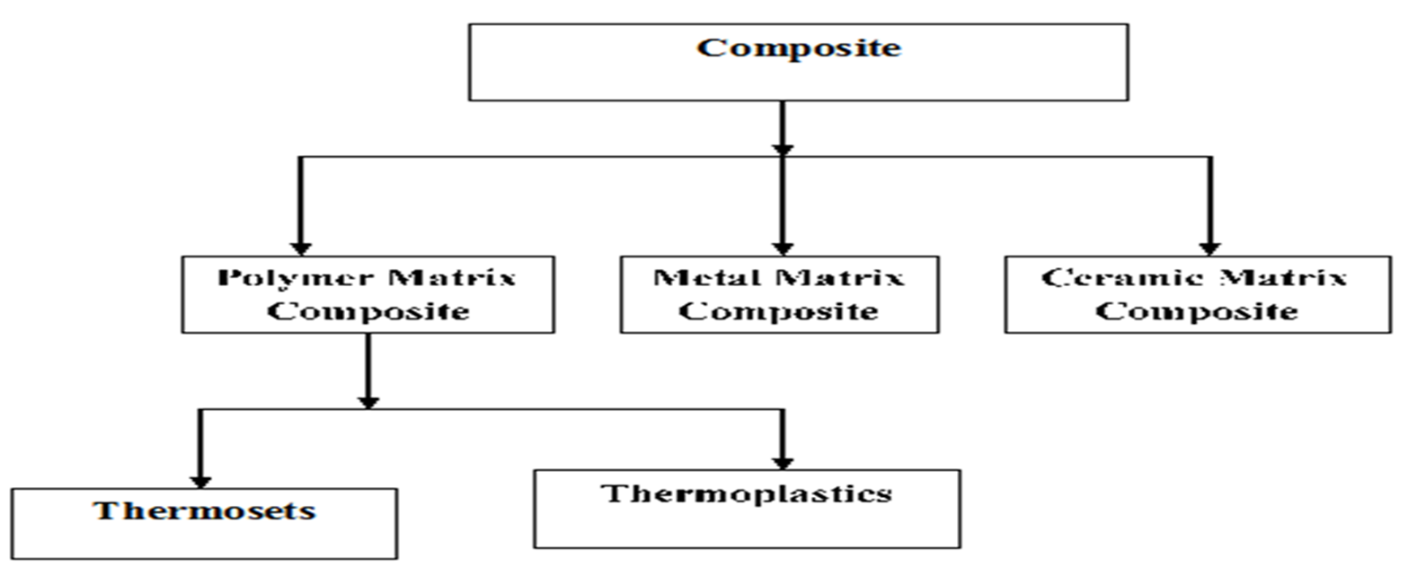
Classifications of Composites

Slide 5
POLYMER MATRIX
Polymer Matrix Composite (PMC) is the material consisting of a polymer (resin) matrix combined with a fibrous reinforcing dispersed phase. Polymer Matrix Composites are very popular due to their low cost and simple fabrication methods. The synthesis process of polymers by which monomers are linked together to generate long chains composed of repeat unit. The raw materials for synthetic polymer are derived from coal, natural gas and petroleum products.

Slide 6
METAL MATRIX
Aluminum matrix composites (AMMC) are materials in which the ductile metal matrix is reinforced by hard fibers or particulates. In Metal Matrix Composites (MMCs), aluminum and its alloys have attracted most attention as base metal because of its low density, low weight, high strength, superior malleability, easy machining, excellent corrosion resistance and good thermal and electrical conductivity, etc. In AMMC, aluminum acts as the matrix phase and forms percolating network. These AMMCs offer a large variety of mechanical properties depending on the chemical composition of the Al-matrix. Aluminum alloys, such as the 2000, 5000, 6000 and 7000 alloy series are the most commonly utilized materials in composite fabrication. Addition of various reinforcements such as fly ash, TiC, SiC, Al2O3, TiO2, B4C etc., to aluminum matrix will enhance the mechanical and tribological properties. In recent years, Al based composite materials have gained significance in aerospace, automotive and structural applications due to their enhanced mechanical properties and good stability at high temperature.

Slide 7
CERAMIC MATRIX
Ceramic matrix composites reinforced with long fibers are commonly fabricated by infiltration methods. In this group of fabrication techniques the ceramic matrix is formed from a fluid (gaseous or liquid) infiltrated into the fiber structure (either woven or non-woven). Ceramic composites may be produced by traditional ceramic fabrication methods including mixing the powdered matrix material with the reinforcing phase followed by processing at elevated temperature: hot pressing ,sintering. Such fabrication routs are successfully employed for preparing composites reinforced with a discontinuous phase.

Slide 8
LITERATURE SURVEY
S. CHANDRASEKHAR, deals with the preparation and mechanical characterization of aluminum 6063metal matrix reinforced with silicon carbide and graphite. Silicon carbide and graphite can be considered in different percentages like (1+2), (3+2), (5+2). By using these materials to prepare and investigate the mechanical characteristics like ultimate tensile strength, breaking strength, Rockwell hardness, Brinell hardness, compression strength and toughness. Aluminum metal composites have various properties which makes it to be applicable into various places like automobile, military industries, aerospace, building constructions and others due to light weight, thermal properties, stiffness, high mechanical strength, corrosion resistance. During the analysis of the composite matrix of aluminum the properties / characteristic were investigated.
The aluminum metal matrix composites reinforced with silicon carbide and graphite fabricated by the stir casting method successfully. According to results with the increase of reinforcement mechanical properties has been increased except compression strength. In compression test at the average value of reinforcement the compression strength has been increased

Slide 9
Karthikeyan et.al. Al7075 alloy composites containing different volume fraction of short basalt fiber are developed using the stir casting process. The experimental strength values of the composites are compared with the theoretical values in this paper. The results suggested that the experimental values best suited the theoretical values owing to the random distribution of basalt fibers in the Al7075 matrix.
Pradeep R et.al observed the study of mechanical properties of Al- Red Mud and Silicon Carbide Metal Matrix Composite (MMC) of Aluminum alloy of grade 7075 with addition of varying weight percentage composition such as SiC8%+Al7075, SiC6%+Red mud2%+ Al7075, SiC4%+Red mud 4%+Al7075, SiC2%+Red mud 6%+Al7075, Red mud 8%+Al7075ed mud and Silicon Carbide particles by stir casting technique. The experimental result reveals that the combination of a matrix material with reinforcement such as Sic and Red mud particles, improves mechanical properties.
Ravichandran M et.al carried out the research work by fabricating aluminum metal matrix composites through liquid powder metallurgy route. The aluminum matrix composite containing TiO₂ reinforcement particle was produced to study the mechanical properties such as tensile strength and hardness.

Slide 10
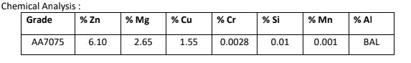
MATERIALS USED
AL 7075 Aluminum Physical Properties
Density (ρ) | 2.81 g/cm3
Melting temperature (T_{m}) | 4770C (8910F)
Thermal conductivity (k) | 130–150 W/m*K

Slide 11
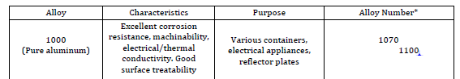
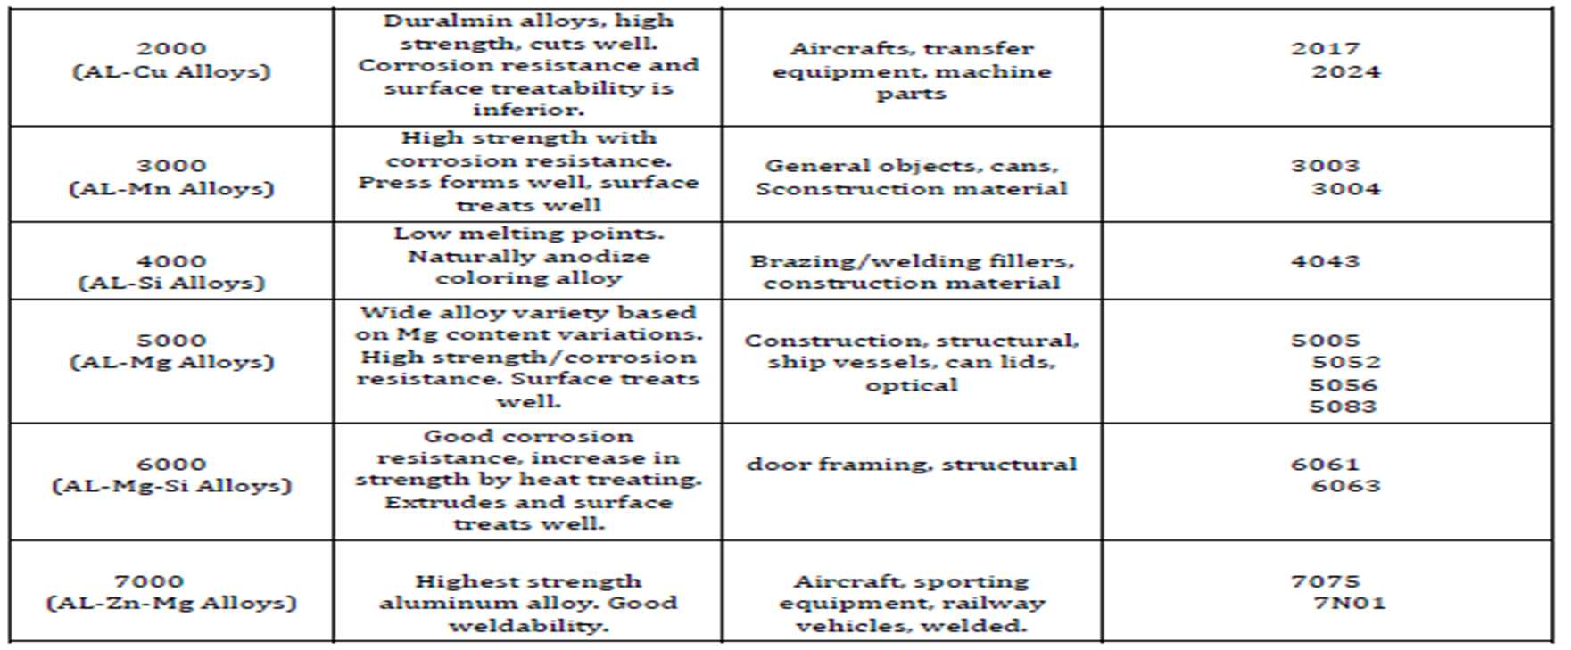

Slide 12
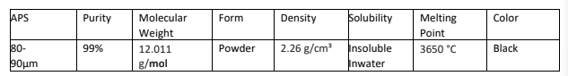
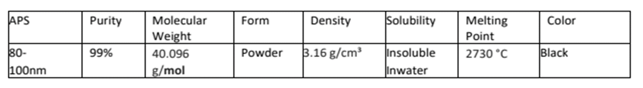
Properties of Graphite
Physical Properties of SIC

Slide 13
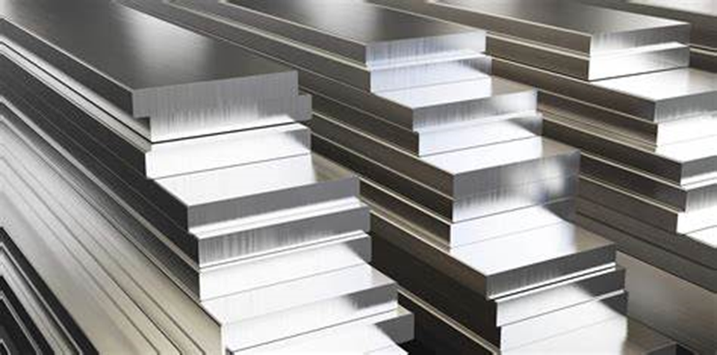
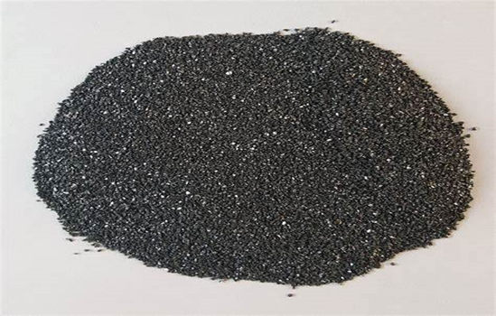
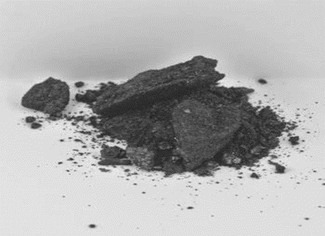
Specimen Composition
S.No | Specimen Name | AL7075(g) | SIC(g) | GRAPHITE (g)
1 | A | 950 | 20 | 30
2 | B | 930 | 40 | 30
3 | C | 910 | 60 | 30
AL-7075
Silicon Carbide
Graphite

Slide 14
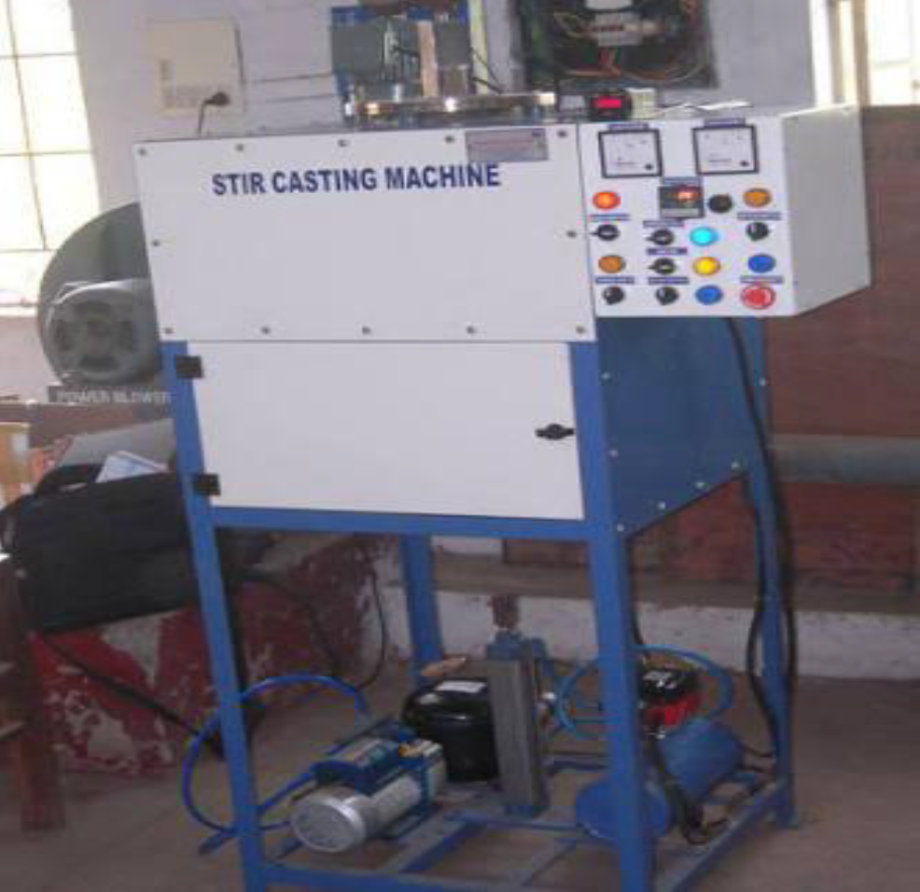
STIR CASTING
Stir casting is one of the most popular and widely used method in which material formation (mainly Metal Alloys and Metal Matrix Composites) is done by melting metals and casting them into suitable shapes and sizes by pouring them into cavities. It is also called as liquid metallurgy
.

Slide 15
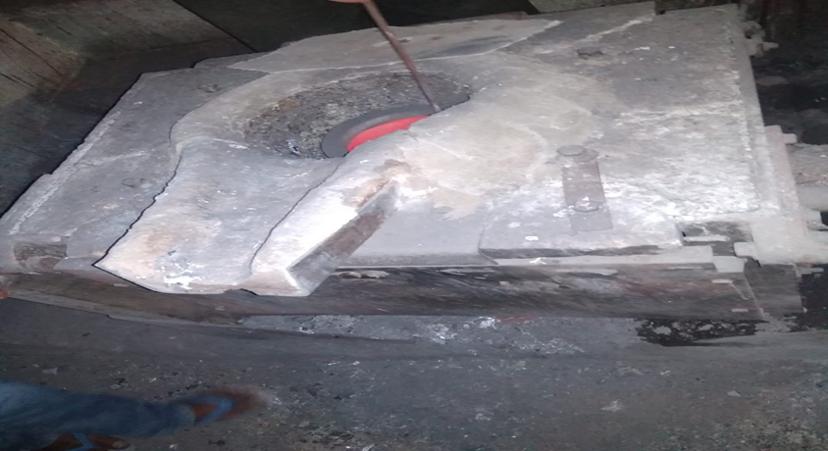
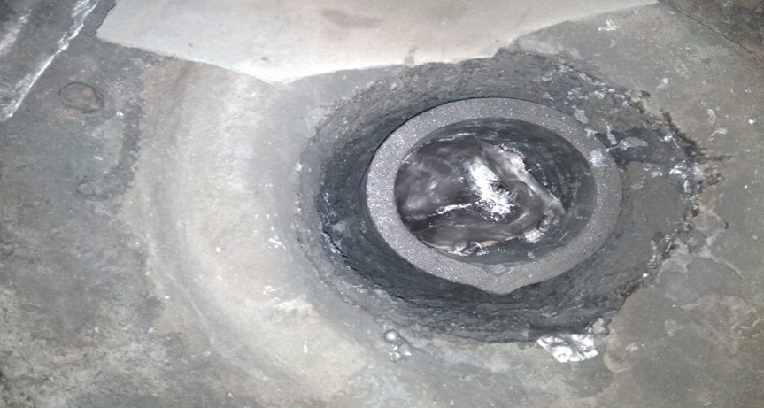
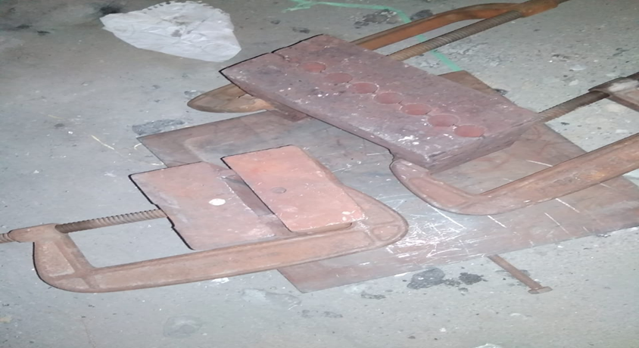
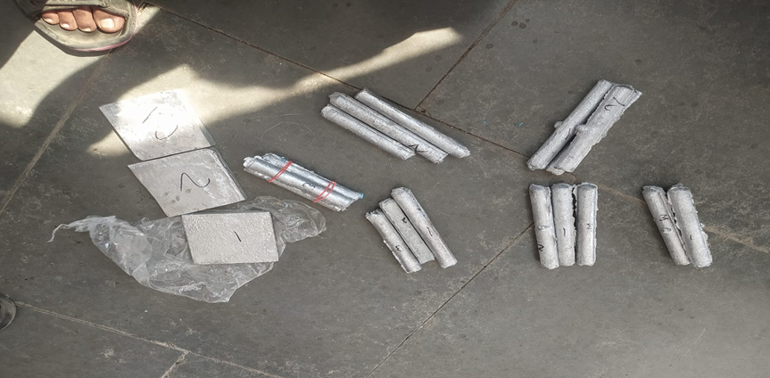
Furnace
Molten Material
Dies
Specimens

Slide 16
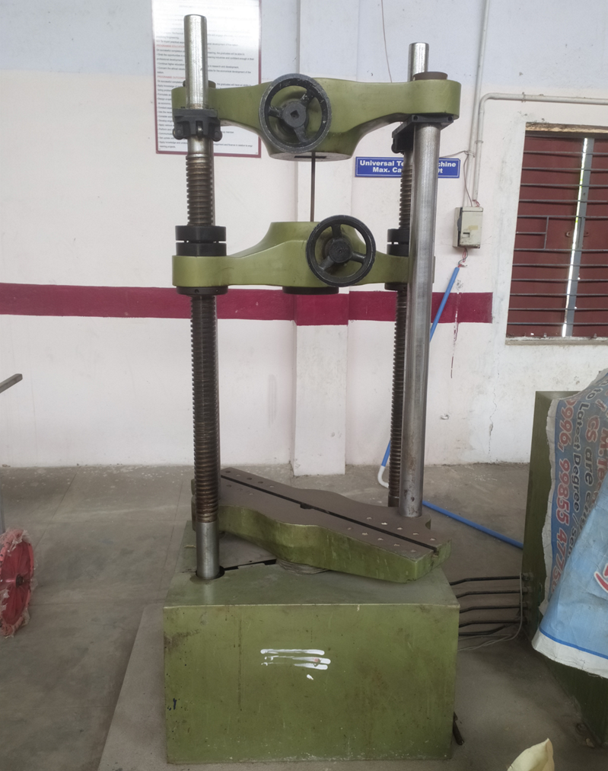
TENSILE TEST
The tensile test procedure involves attaching the sample to the testing machine and applying force until the material fractures. The results are typically recorded in a stress-strain diagram. The most important parameters measured in the test are the ultimate tensile strength, yield strength, and elongation at break. A tensile test is used to determine the yield point or yield strength, tensile strength or ultimate tensile stress, and percentage elongation of a metal. The tensile Testing method measures the force required to break a metallic, composite, or plastic specimen and the extent to which the specimen stretches or elongates to that breaking point

Slide 17
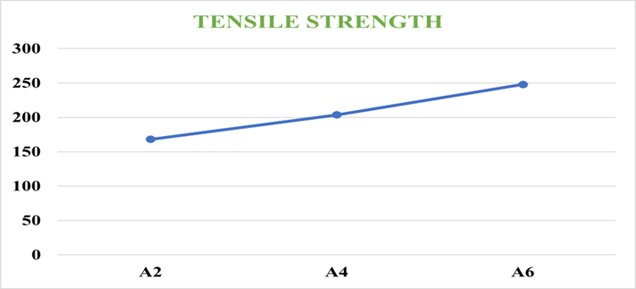
S. No | Material | Gauge length(mm) | Diameter 2r(mm) | Area of the cross section | Breaking load (Kgf) | Breaking strength (KPa)
1 | A2 | 100 | 12 | 113.04 | 190 | 168
2 | A4 | 99 | 12 | 113.04 | 230 | 203.46
3 | A6 | 98 | 12 | 113.04 | 280 | 247.69

Slide 18
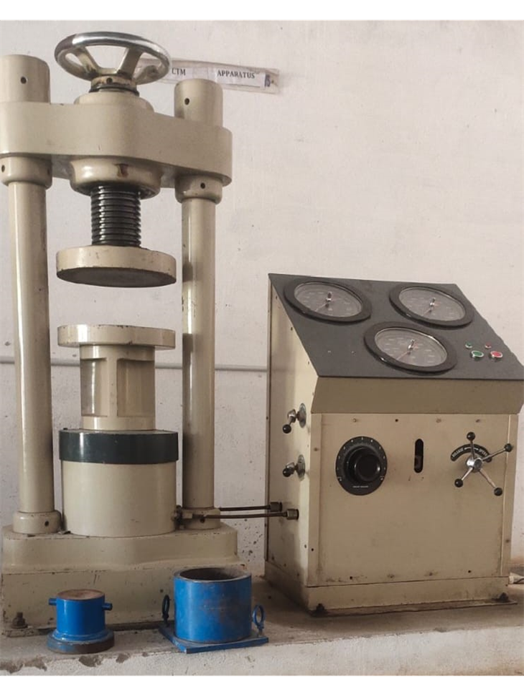
COMPRESSION TEST
In compression testing, the sample or the component is compressed between two moving platens. A load cell and an extensometer or strain gauge are used to measure load and displacement. Compression tests are useful for testing material or component load-bearing capabilities under compressive loads. Compression pressure, for example, is taken into account in the design of tower structures, columns, bridge structures, and other load-bearing structures. The test is quite simple to conduct as well as the preparation of samples for testing

Slide 19
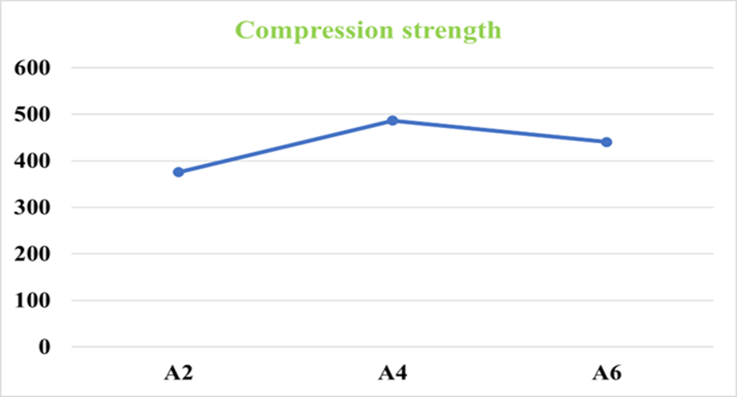
S.No | Diameter | Length | Area A(mm²) | Load(P) KN | Compression strength (N/mm²)
A2 | 20 | 40 | 314.15 | 118 | 375.61
A4 | 19.48 | 39.5 | 298.03 | 145 | 486.52
A6 | 19.54 | 39 | 299.87 | 132 | 440.19

Slide 20
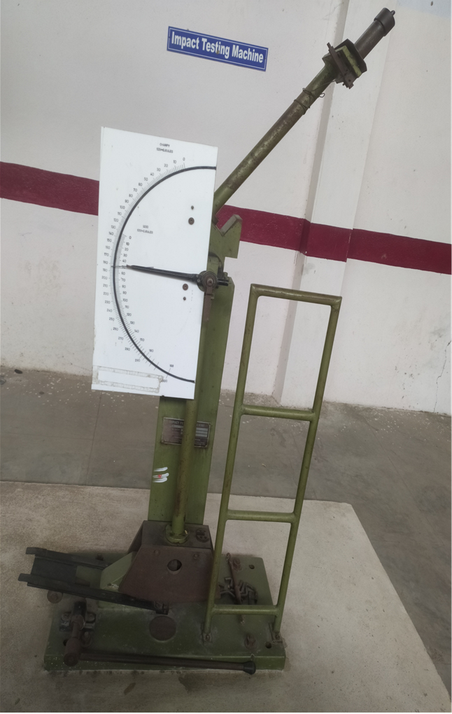
IMPACT TEST
Toughness is, broadly, a measure of the amount of energy required to cause an item a test piece or a bridge or a pressure vessel to fracture and fail. The more energy that is required then the tougher the material. From this work the science of fracture toughness developed and gave rise to a range of tests used to characterize 'notch toughness' of which the Charpy-V test described in this article is one. There are two main forms of impact test, the Izod and the Charpy test.

Slide 21
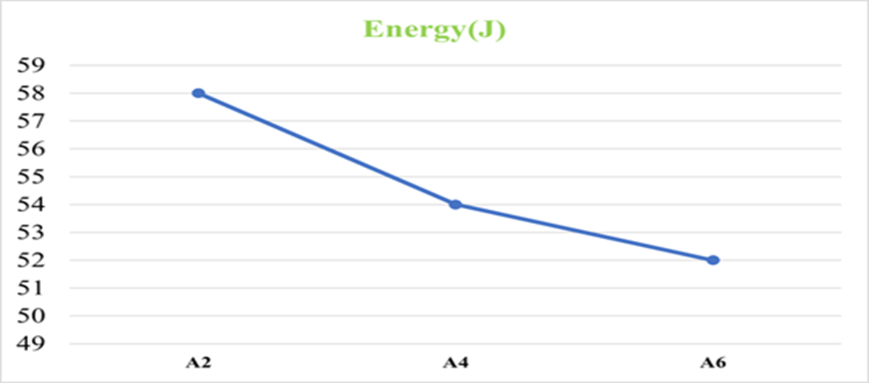
S. No | Material | Energy(j)
1 | A2 | 58
2 | A4 | 54
3 | A6 | 52

Slide 22
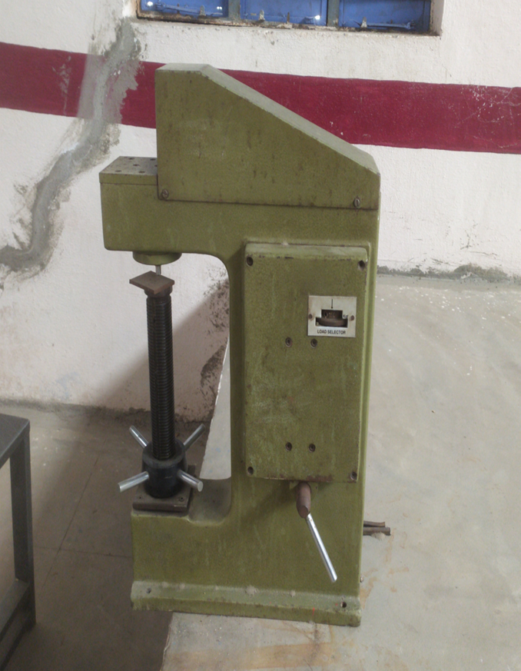
HARDNESS TEST
Heat treating has evolved into a highly complex, precise process that improves characteristics of metal parts. A critical component of quality heat treating is employing the correct hardness testing method to show manufacturers their parts achieve design requirements.
Hardness testing methods vary based on the material and heat treatment chosen. It’s important that engineers specify hardness testing methods correctly to ensure timely heat treatment and avoid costly delays. Common hardness testing methods are introduced below.

Slide 23
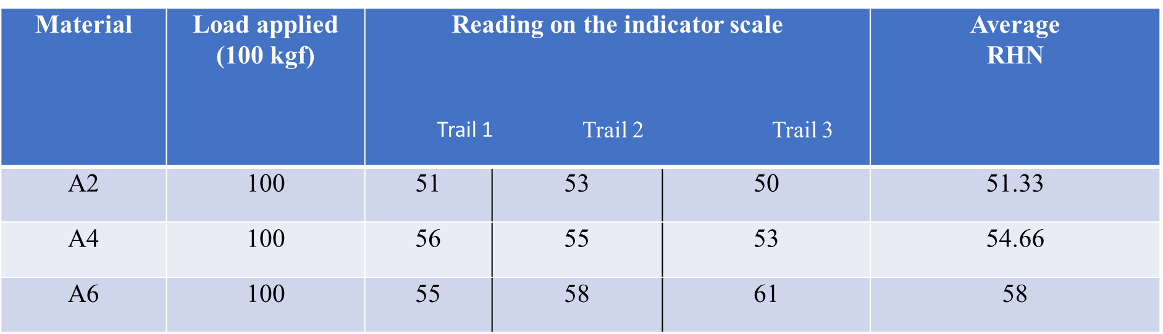
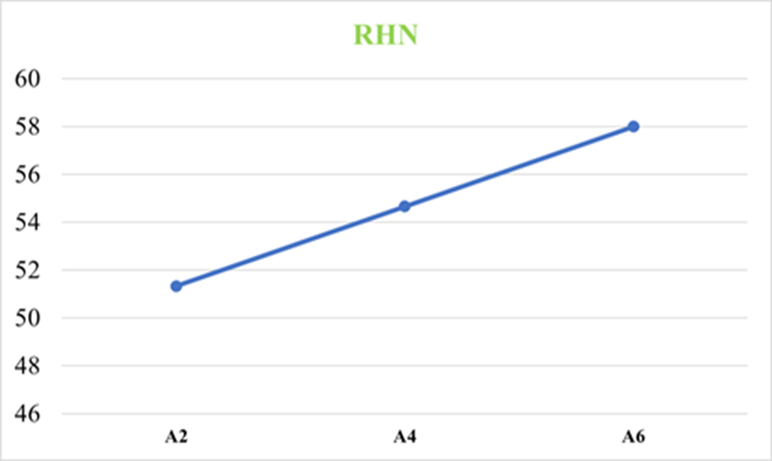

Slide 24
advantages
Chemical Resistance.
Consolidated Parts and Function.
Corrosion Resistance.
Design Flexibility.
Durable.
High Flexural Modulus
High Impact Strength.
High Performance at Elevated Temperatures.

Slide 25
conclusion & result
The fabrication of hybrid metal matrix composites reinforced with silicon carbide and graphite by stir casting method was completed successfully. According to the results,
In Tensile test, we observed that as increasing the SiC percentage, the tensile strength increases gradually. We observe the highest strength in our investigation A6 specimen i.e. 247.69 KPa.
In Compression test, we observed that as increasing the SiC percentage, the compression strength increases first and decreases gradually. We observe the highest strength in our investigation A4 specimen i.e. 486.52 N/mm².
In Impact test, we observed that as increasing the SiC percentage, the energy decreases gradually. We observe the highest energy in our investigation A2 specimen i.e. 58 J.

Slide 26
In Rockwell hardness test, we observed that as increasing the SiC percentage, the hardness value increases gradually. We observe the highest hardness value in our investigation A6 specimen i.e. 58.
In Brinell hardness test, we observed that as increasing the SiC percentage, the hardness value increases gradually. We observe the highest hardness value in our investigation A6 specimen i.e. 5.61.

Slide 27
Applications
Aerospace Thermoset composites are being specified for wings, fuselages, bulkheads, and other applications in commercial, civilian and military aerospace applications.
Appliance/Business Thermoset composite are being used in frames, equipment panels, handles and trims in appliances, power tools, business equipment and many other applications.
Thermoset composites for the appliance industry are used in washers, dryers, refrigerators, freezers, ranges, ovens, dishwashers for components that include control panels, handles, knobs, vent trims, side trims, motor housings, kick plates and many others.
Automotive/Transportation/Farm/Construction Composites are now being used in vehicle and equipment applications, including, panels, frames, interior components and other parts.

Slide 28
Construction Thermoset composites are replacing many traditional materials for home and offices architectural components including fixtures, doors, wall panels, roofing, window frames, molding, vanity sinks, shower stalls and even swimming pools.
Corrosive Environments Composites are ideal for applications in corrosive environments, such as chemical processing plants, pulp and paper converting, oil and gas refineries and water treatment facilities. Common applications include fans, grating, tanks, ducts, hoods, pumps and cabinets..
Marine With their corrosion resistance and light-weighting attributes, Marine composite applications include boat hulls, bulkheads and other components for military, commercial and recreational boats and ships.

Slide 29
REFERENCES
[1] Ramesh CS, Keshavamurthy R, Channabasappa BH, Pramod S. Friction and wear behavior of Ni–P coated Si3N4 reinforced Al6061 composites. Tribal Int 2001; 43(March (3)):623–34.
[2] Tjong SC, Tam KF. Mechanical and thermal expansion behavior of hipped aluminum-TiB2 composites. Mater Chem. Phys 2006; 97(May (1)):91–7.
[3] William C, Harridan J. Commercial processing of metal matrix composites. Mater Sic Eng A 1998; 244(75):79.
[4] Akhlaghi F, Lajevardi A, Maghanaki HM. Effects of casting temperature on the microstructure and wear resistance of compost A356/Sic composites: a comparison between SS and SL routes. J Mater Process Technol 2004; 155–156:1874–80.
[5] Rosso M. Ceramic and metal matrix composites: routes and properties. J Mater Process Techno 2006; 175(June (1–3)):364–75.

Slide 30
[6] Seyed Reihani SM. Processing of squeeze cast Al6061-30 vol. % Sic composites and their characterization. Mater Des 2006; 27(3):216–22.
[7] Estrada-Guel I, Carreno-Gallardo C, Mendoza-Ruiz DC. Graphite nanoparticle dispersion in 7075 aluminum alloy by means of mechanical alloying. J Alloys Comp 2009; 483(August (1–2)):173–7.
[8] Habibur Rahmana Md, Mamun Al Rashedb HM. Characterization of silicon carbide reinforced aluminum matrix composites. In: 10th International Conference on Mechanical Engineering (ICME 2013). 2014. p. 103–9.
[9] Ramakoteswara Rao V, Ramanaiah N, Sacra MMM. Tribological properties of Aluminum Metal Matrix Composites (AA7075 Reinforced with Titanium Carbide (TiC) Particles). Int J Adv Sic Techno 2016; 88:13–26.
[10] M.Vamsi Krishna, Anthony. M. Xavier, An Investigation on the Mechanical Properties of Hybrid Metal Matrix Composites,12th Global Congress on Manufacturing and Management, (GCMM 2014), Procedia Engineering 97918 ( 2014 ) - 924, doi: 10.1016

Slide 31
VIDEOS
https://drive.google.com/file/d/1uK7yOPN29qkN6v_1cu-2M0gx70F7_XDj/view?usp=share_link

Slide 32
Thank You

